Slide 1
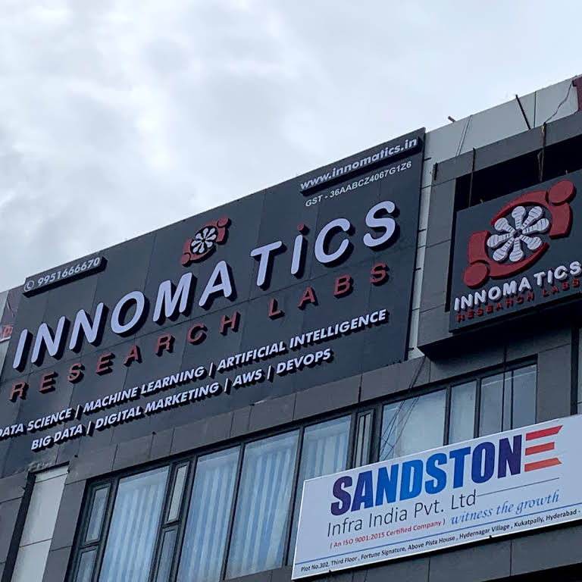
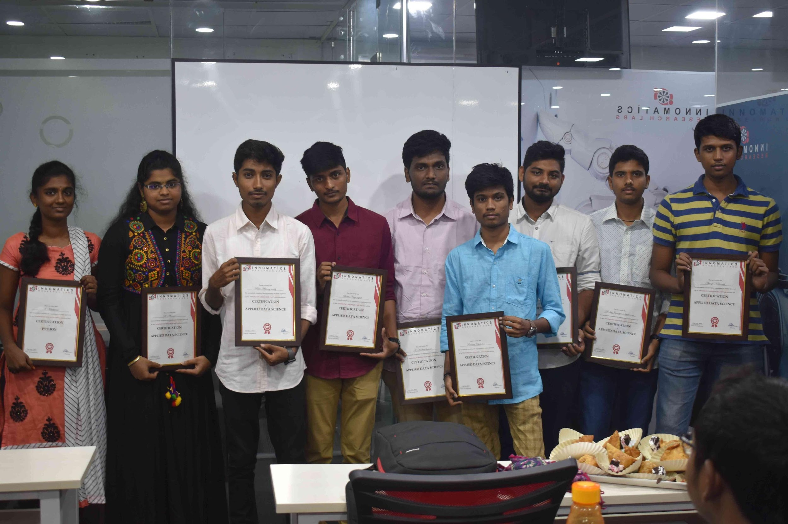
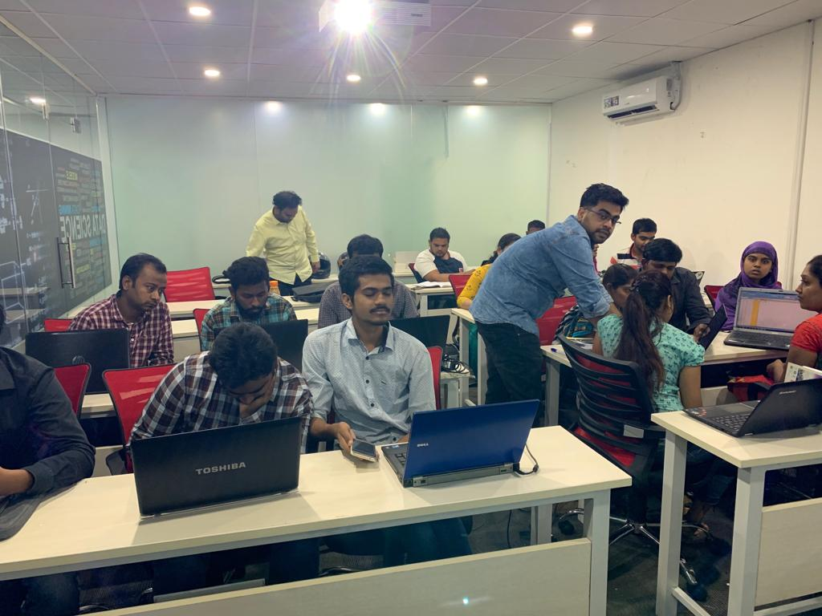

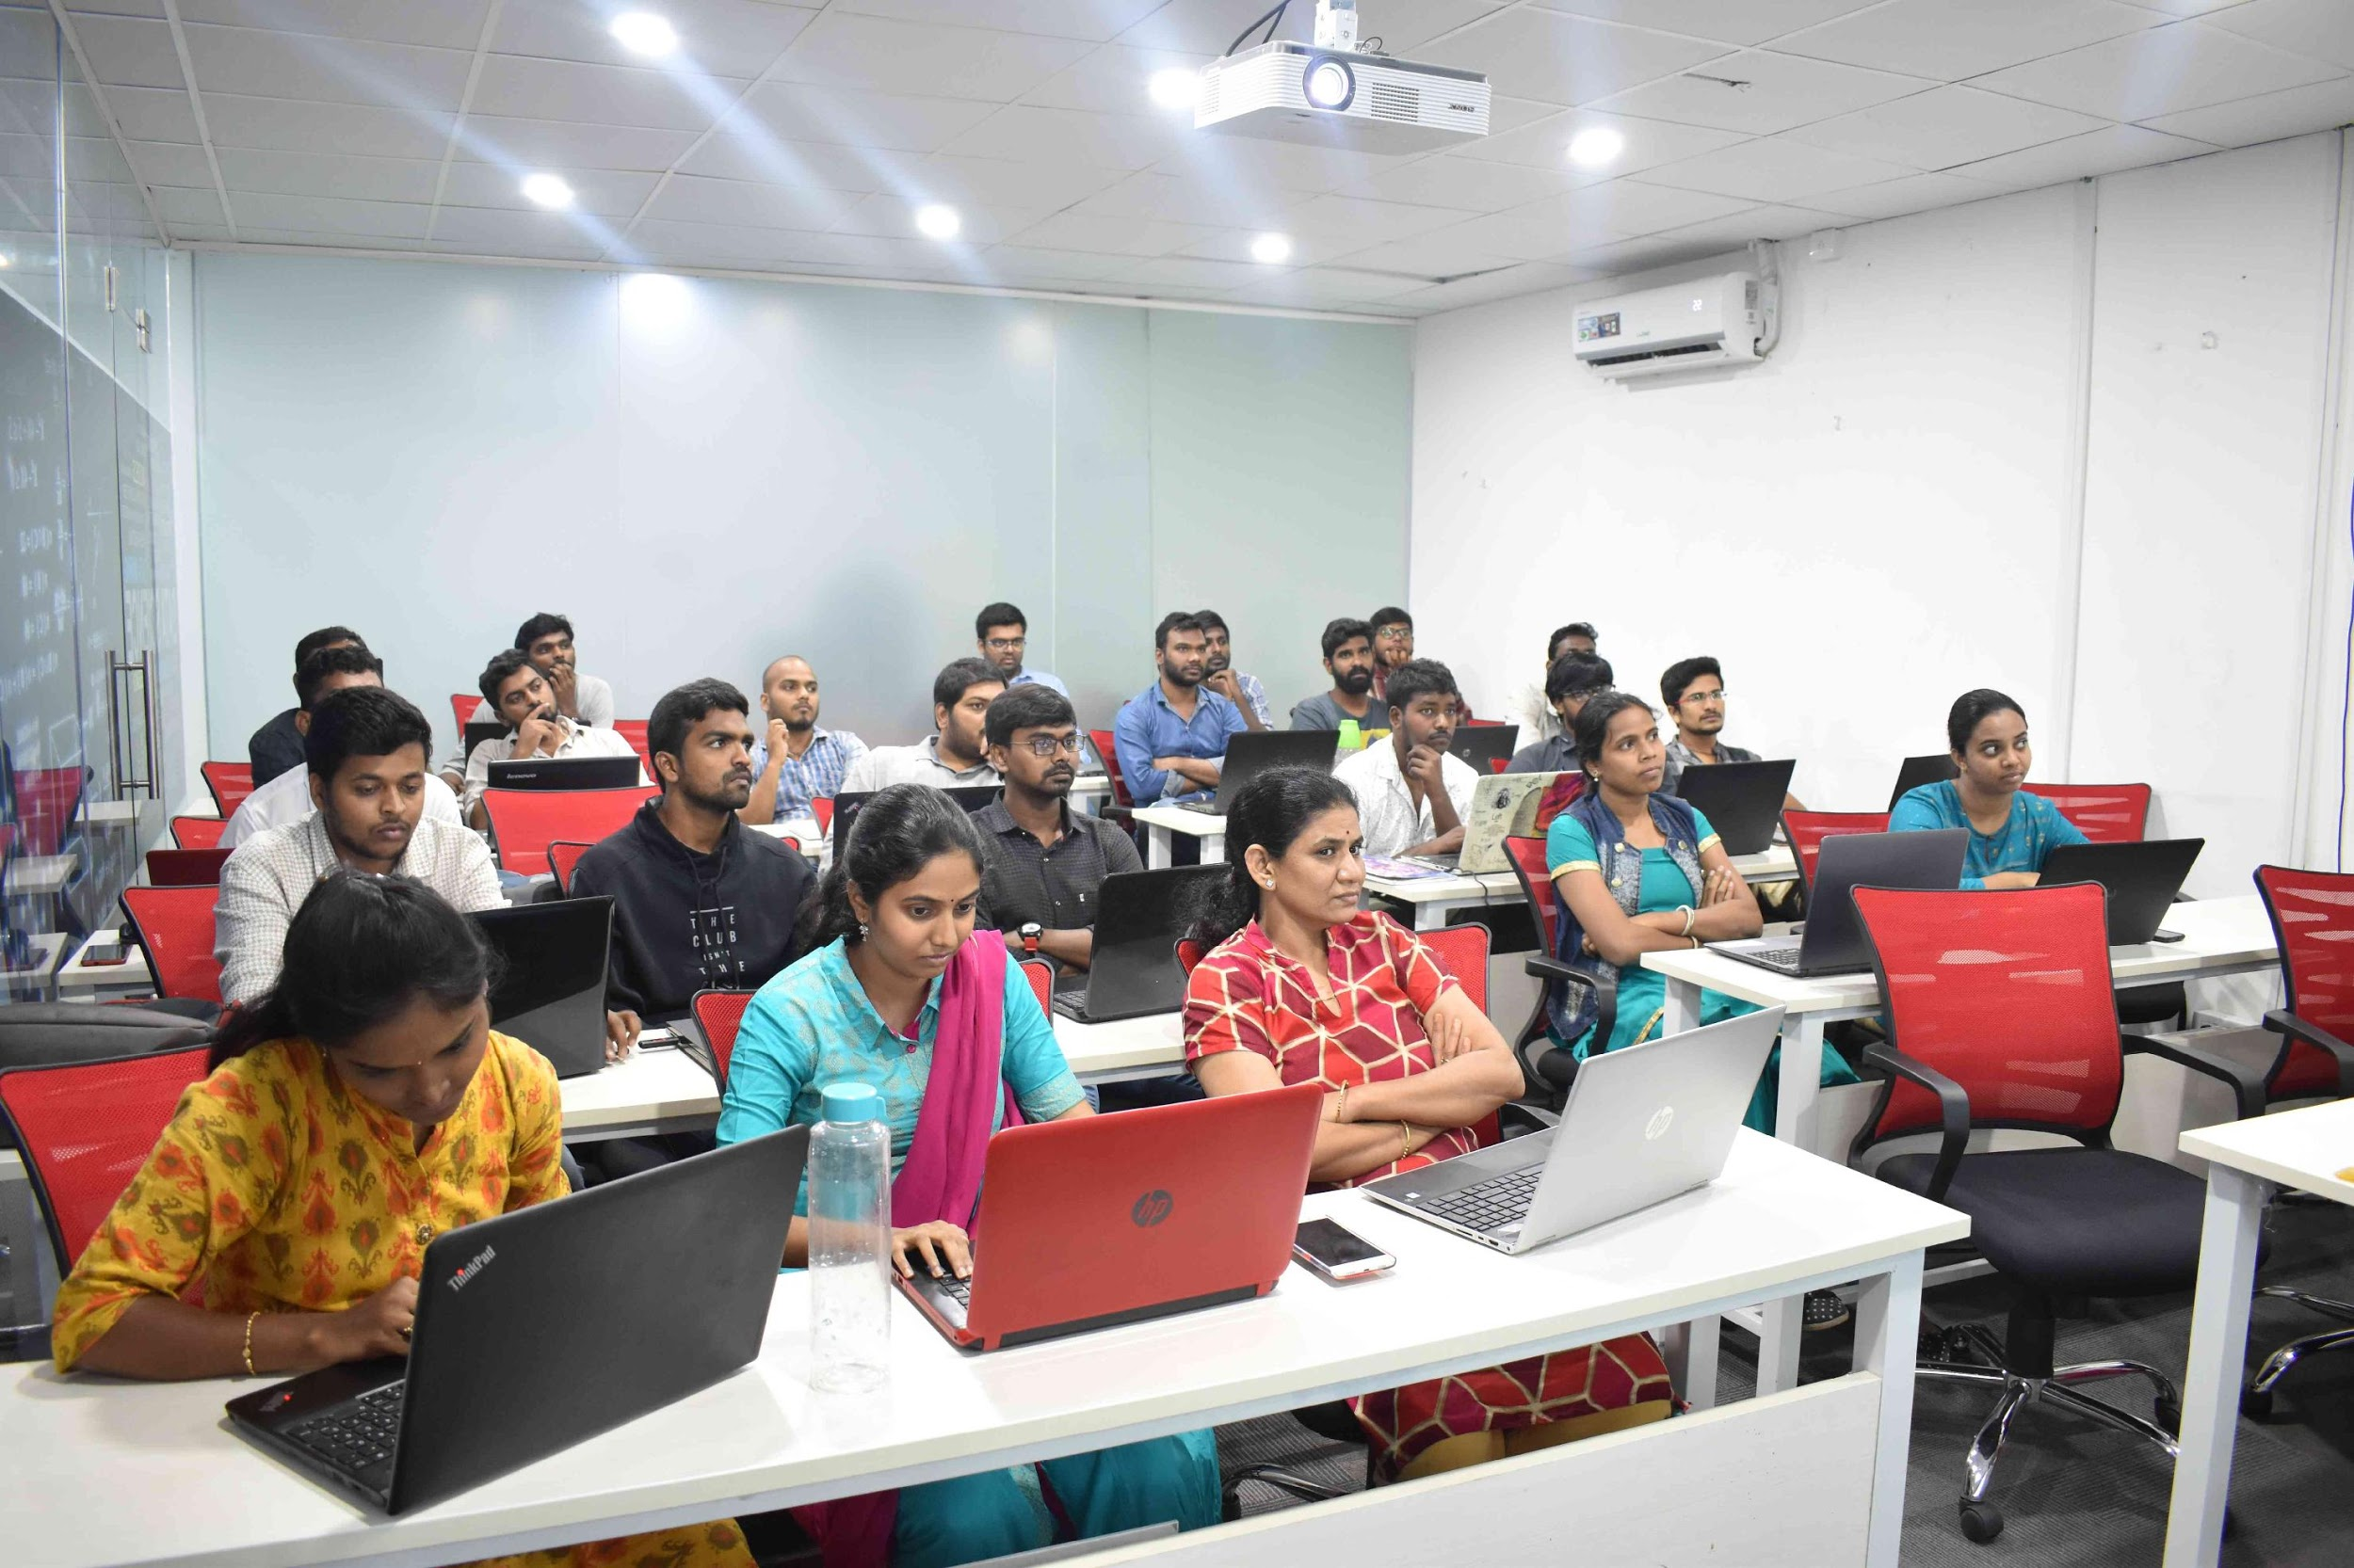
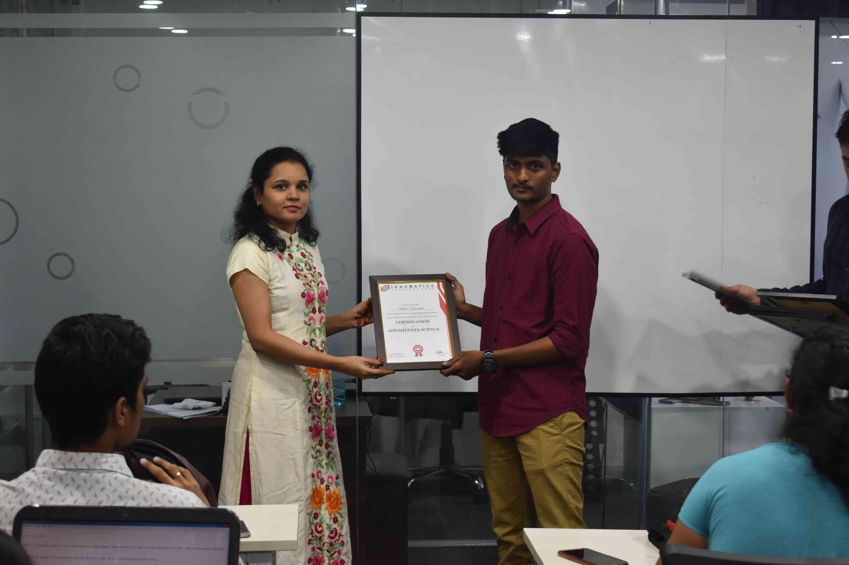
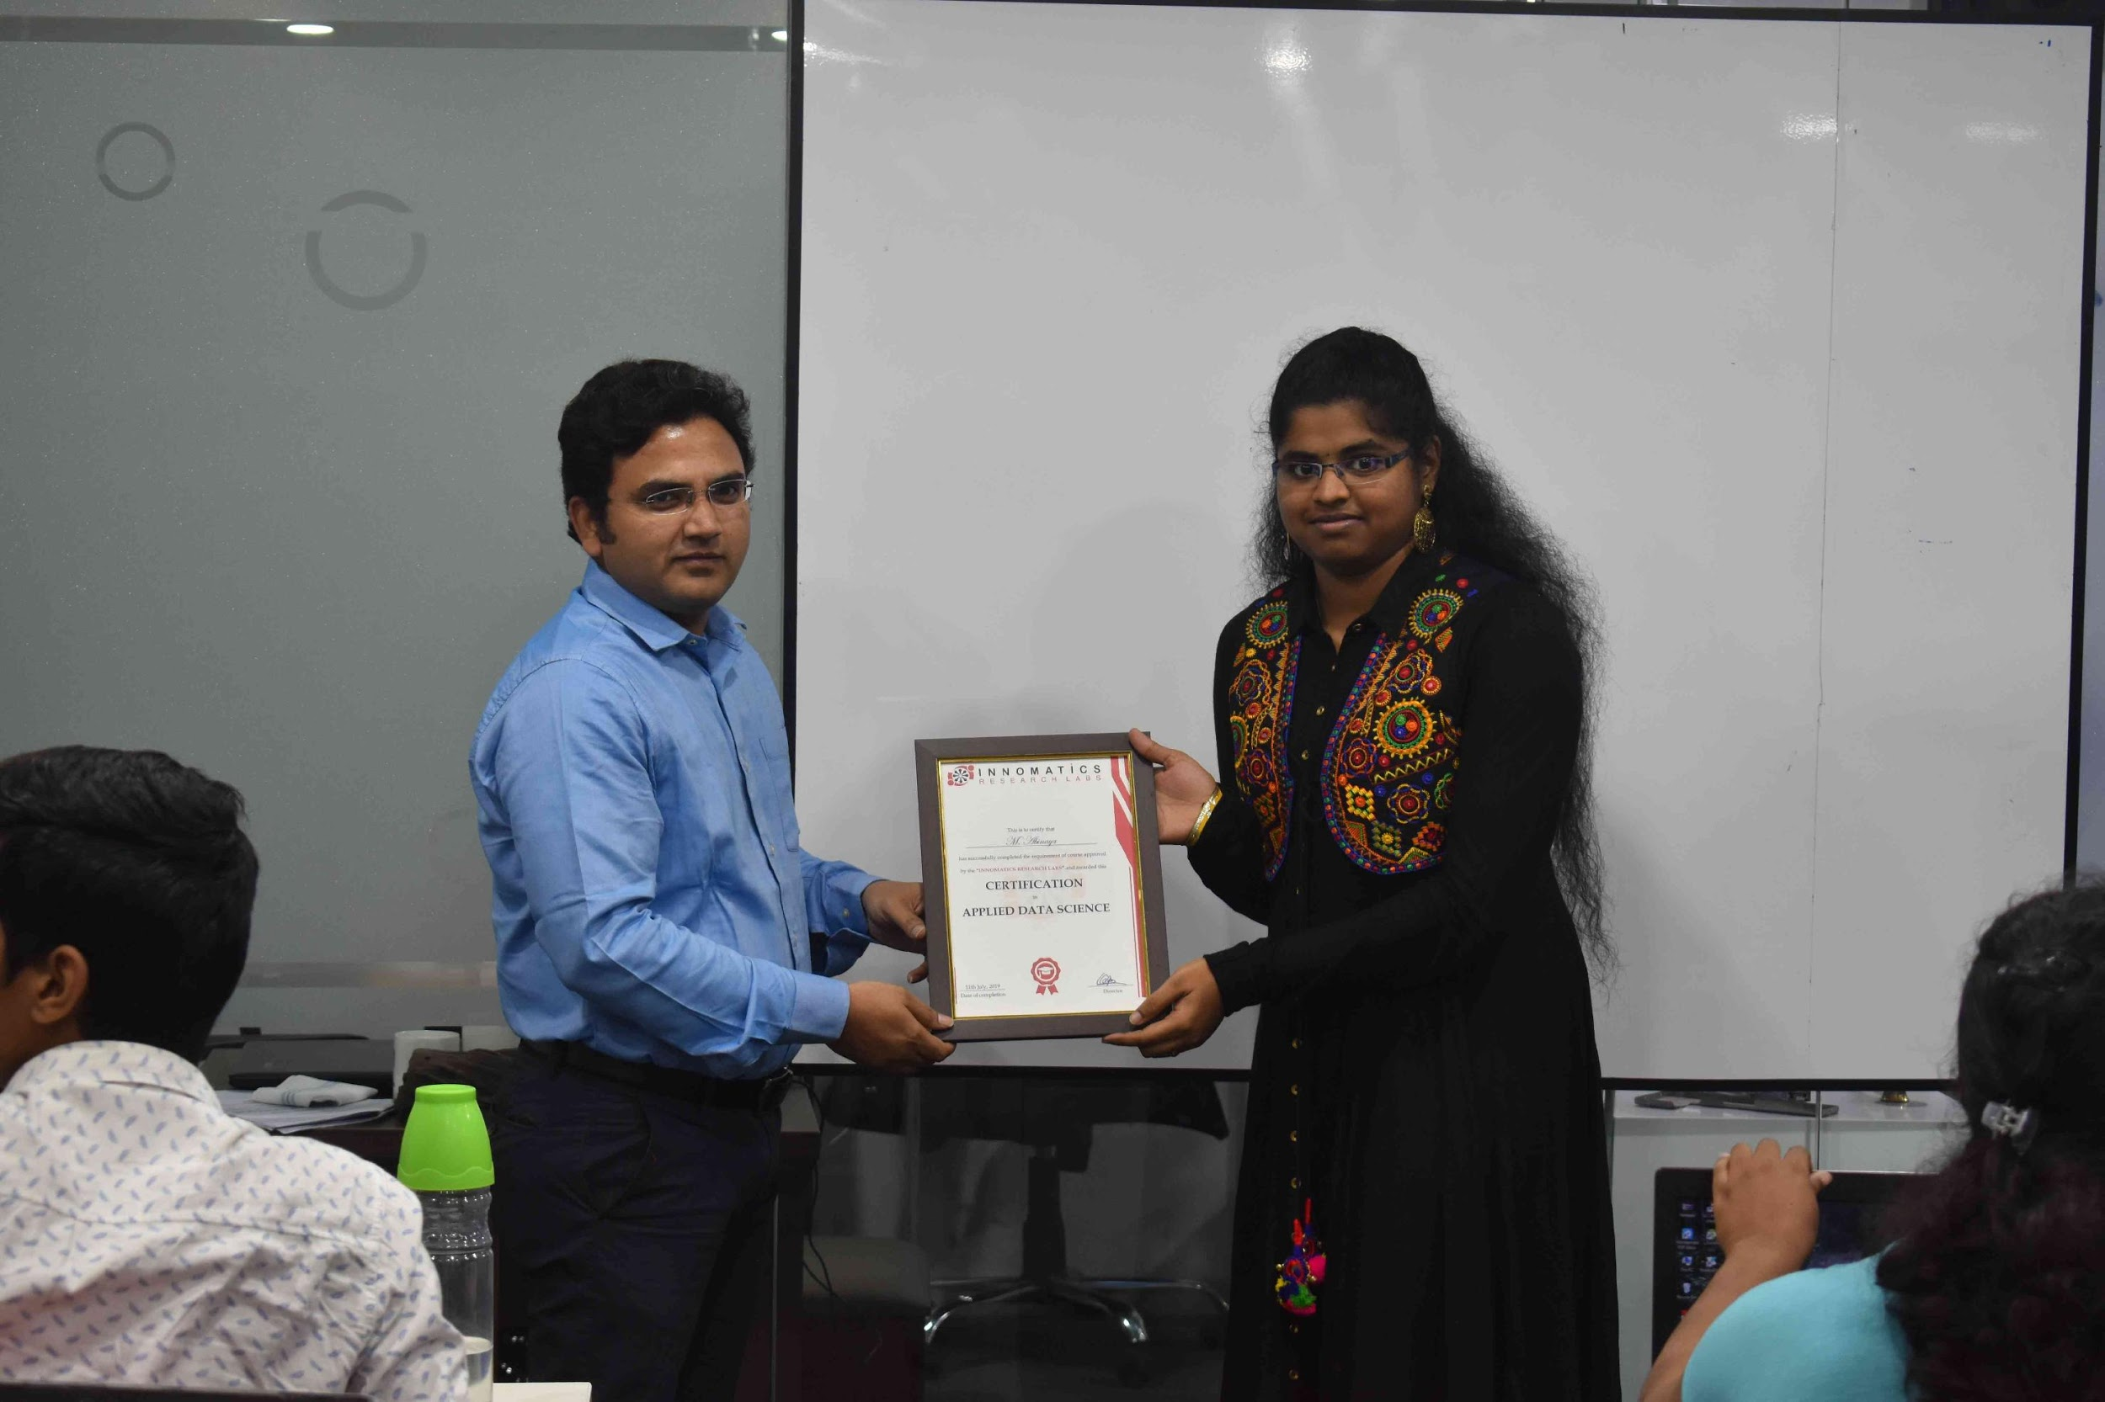

Slide 2
Music Recommender System
Hybrid Recommender

Slide 3
Recommender System
Recommender systems are machine learning systems that help users discover new product and services. Every time you go online, a recommendation system is guiding you towards the most likely choice you might make.
Recommender systems are an essential feature in our digital world, as users are often overwhelmed by choice and need help finding what they're looking for. This leads to happier customers and, of course, more sales. Recommender systems are like salesmen who know, based on your history and preferences, what you like.

Slide 4
Approaches in Recommender System
Collaborative Filtering
Content Based
Knowledge Based
Demographic Recommender System

Slide 5
Limitations in Recommender System
Data sparsity
In practice, many commercial recommender systems are based on large datasets. As a result, the user-item matrix used for collaborative filtering could be extremely large and sparse, which brings about the challenges in the performances of the recommendation
Scalability
As the numbers of users and items grow, traditional CF algorithms will suffer serious scalability problems
Cold start Problem
The cold start problem is a typical problem in recommendation systems. The “cold start" problem happens in recommendation systems due to the lack of information, on users or items.

Slide 6
Final approach
After applying all the different approach to overcome all the limitation and to build personalized recommender system. we gonna use
Hybrid Recommender system

Slide 7
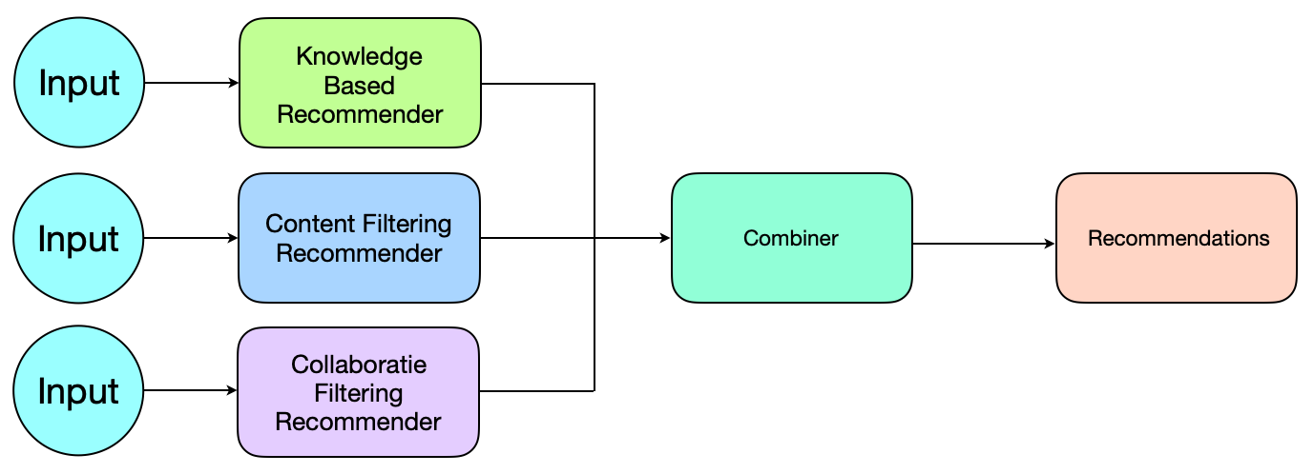
Hybrid recommender systems
Hybrid: combinations of various inputs and/or composition of different mechanism
Collaborative: "Tell me what's popular among my peers"
Content‐based: "Show me more of the same what I've liked"
Knowledge‐based: "Tell me what fits based on my needs"

Slide 8
All three base techniques are naturally incorporated by a good Recommender system (at different stages of the recommendation) but have their shortcomings
For instance, cold start problems

Slide 9
Idea of crossing two (or more) recommendation system
– hybrida [lat.]: denotes an object made by combining two different elements
– Avoid some of the shortcomings
– Reach desirable properties not (or only inconsistently) present in parent individuals

Slide 10
Different hybridization designs
– Parallel use of several systems
– Monolithic exploiting different features
– Pipelined invocation of different systems

Slide 11
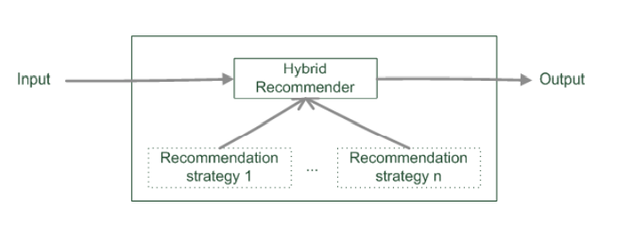
Monolithic hybridization design
Only a single recommendation component
Hybridization is "virtual" in the sense that
– Features/knowledge sources of different paradigms are combined

Slide 12
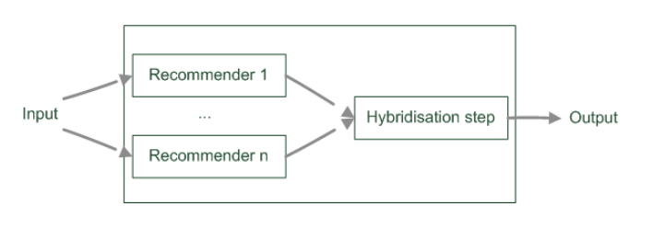
Parallelized hybridization design
Output of several existing implementations combined
Least invasive design
Some weighting or voting scheme
– Weights can be learned dynamically
– Extreme case of dynamic weighting is switching

Slide 13
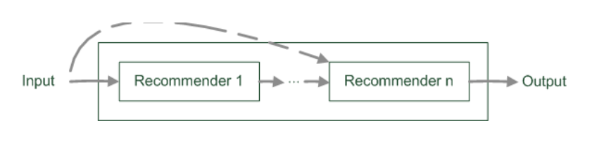
Pipelined hybridization design
One recommender system pre‐processes some input for the subsequent one
– Cascade (Successor's recommendations are restricted by predecessor)
– Meta‐level (Successor exploits a model delta built by predecessor)
Refinement of recommendation lists (cascade)
Learning of model (e.g. collaborative knowledge‐based meta‐level)

Slide 14
Limitations of hybridization strategies
Only few works that compare strategies from the meta‐perspective
– Most datasets do not allow to compare different recommendation paradigms i.e. ratings, requirements, item features, domain knowledge, critiques rarely available in a single dataset

Slide 15
Future Scope
Our current Hybrid model have some bugs, we try to fix it and will make it more efficient.

Slide 16
About Team Members
Ashok Sihag
I am Ashok Sihag. B.tech in Mechanical Engineering
Pursing PGP in Data Science for career transition
4+ years as Quality Engineer
What I liked most about Innomatics Research lab is practical approach, providing more assignments for practice and learning not just theory.
Ratnesh Puri Goswami
I am Ratnesh Puri Goswami, currently pursuing B.tech specialized in AI and ML
I am in 2nd year right now.
Zeeshan Chitapure
I am Zeeshan Chitapure B.E. Mechanical.
Recently I completed ML/AI training from Symbiosis FST program.
This project helped me to understand different aspects of recommendation system and improves my team player skills

Slide 17
Rayeesa Fathima
I am Rayeesa Fathima.
I am currently pursuing my Final Year B.tech in Computer Science Engineering
With Innomatics I see my knowledge grow in Data Science field in a very consistent manner. The tasks and assignments given have helped me work on real time data sets explore new modules and much more
With project I see my team skills grow

Slide 18

THANK YOU

